Slide 1
Evaluation of Microservice Architecture Designs in an IoT-Context
Abramov Sviatoslav svyatabram@gmail.com
Supervisor: Prof. Dr.-Ing Günter Schäfer
Supervisor: Associate Prof. Dr. Igor Anikin

Slide 2
Content
Introduction
Requirements
State of the Art
The system overview
Results
Conclusion
Future Work

Slide 3
Introduction
The thesis overview

Slide 4
Introduction
The main goal is to find the best MSA architecture design of in an IoT context.
We compared:
Interconnection methods
Database management systems
Load balancing strategies

Slide 5
What we have done
Analyzed most demanded technologies in MSA context.
Built the MSA application, satisfying most common requirements.
Developed a load generation, simulating IoT devices.
Implemented a monitoring system
Processed measurements.

Slide 6
Requirements
The system requirements

Slide 7
Functional requirements
Provide connectivity for IoT devices.
Provide basic authentication system.
Transform IoT device data model to the system data model.

Slide 8
Non-functional Requirements
Qualitative
Quantitative
Testable
Reproducible
Deployable
Response time
Scalable

Slide 9
State of the art
Literature overview

Slide 10
Basic articles
M. S. Hatem Hamad and R. Abed, “Performance evaluation of restful web services for mobile devices,” Computer Engineering Department, Islamic University of Gaza, Palestine, International Arab Journal of e-Technology, 2010.
In the article advantages of RESTful web services before SOAP web services are shown:
RESTful web services provide less message size.
RESTful web services provide less response time.

Slide 11
Basic articles
P. J. Amaral M. and C. D., “Performance evaluation of microservices architectures using containers.,” IEEE 14th International Symposium on Network Computing and Applications, 2015.
In this article Server Virtualization provides performance improvement is shown.
SV increases a server throughput
SV decreases a server latency

Slide 12
Basic articles
J. F. Kunhua Zhu and Y. Li, Research the performance testing and performance improvement strategy in web application”, 2nd international Conference on Education Technology and Computer. 2010.
This article provides a survey about overall MSA based application testing :
Functional and load testing of web MSA based web applications basis.
Prediction of an application response time changing with an increasing user load.
User load impact on application throughput.
Possible bottlenecks caused by system utilization.

Slide 13
The system overview
Explaining the system components

Slide 14
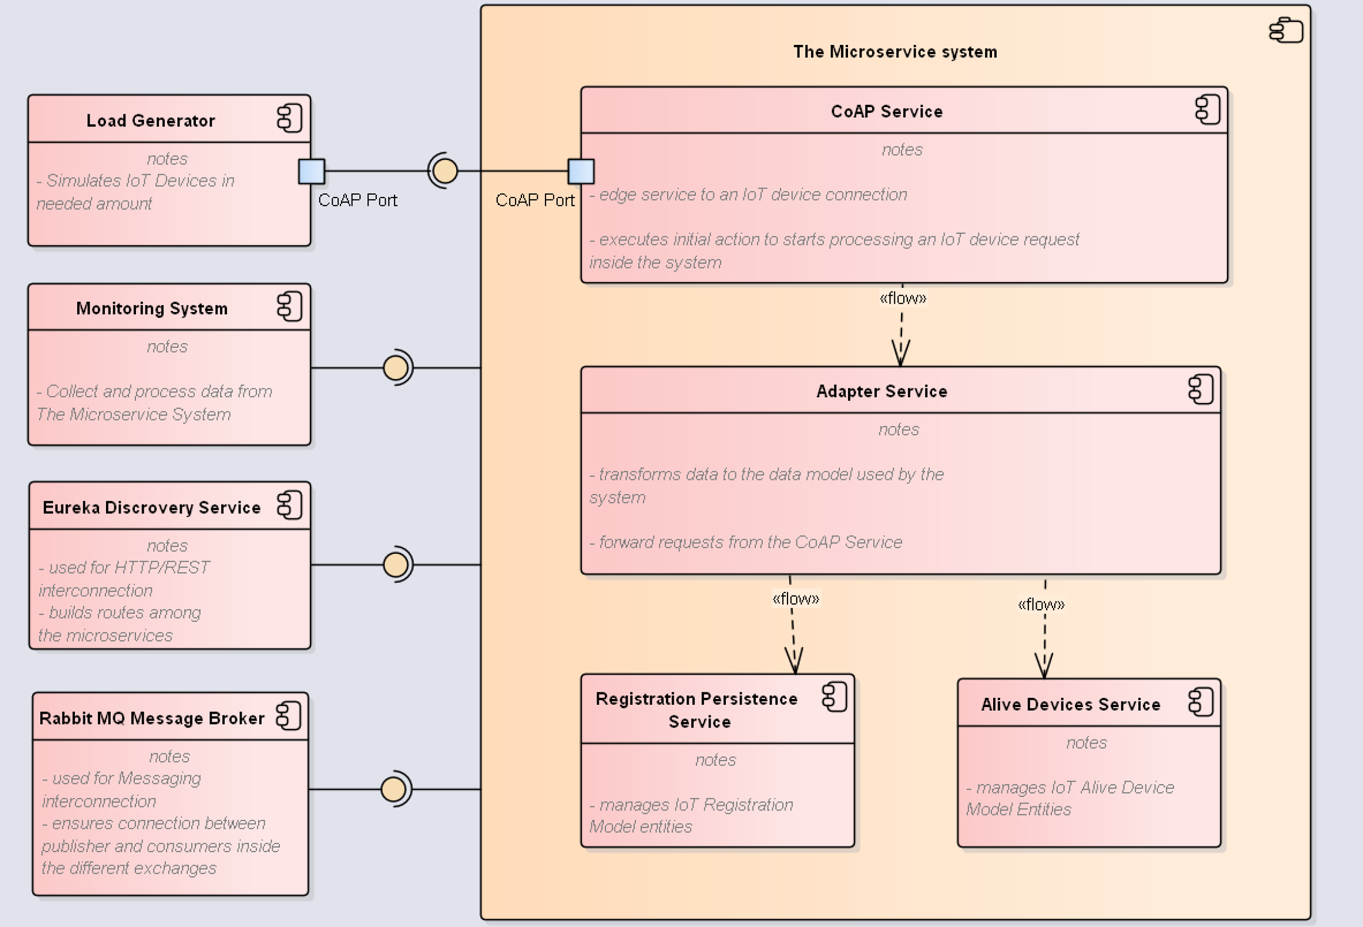
Component diagram

Slide 15
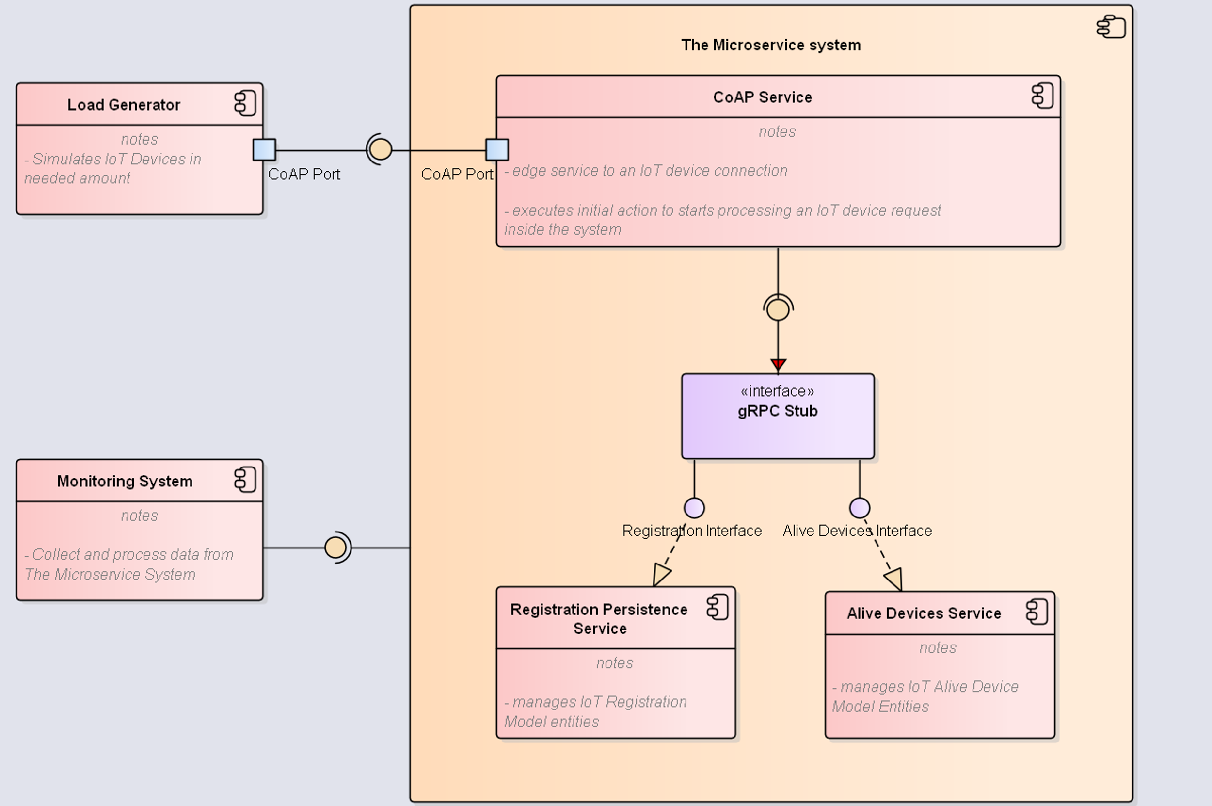
Component diagram (gRPC)

Slide 16
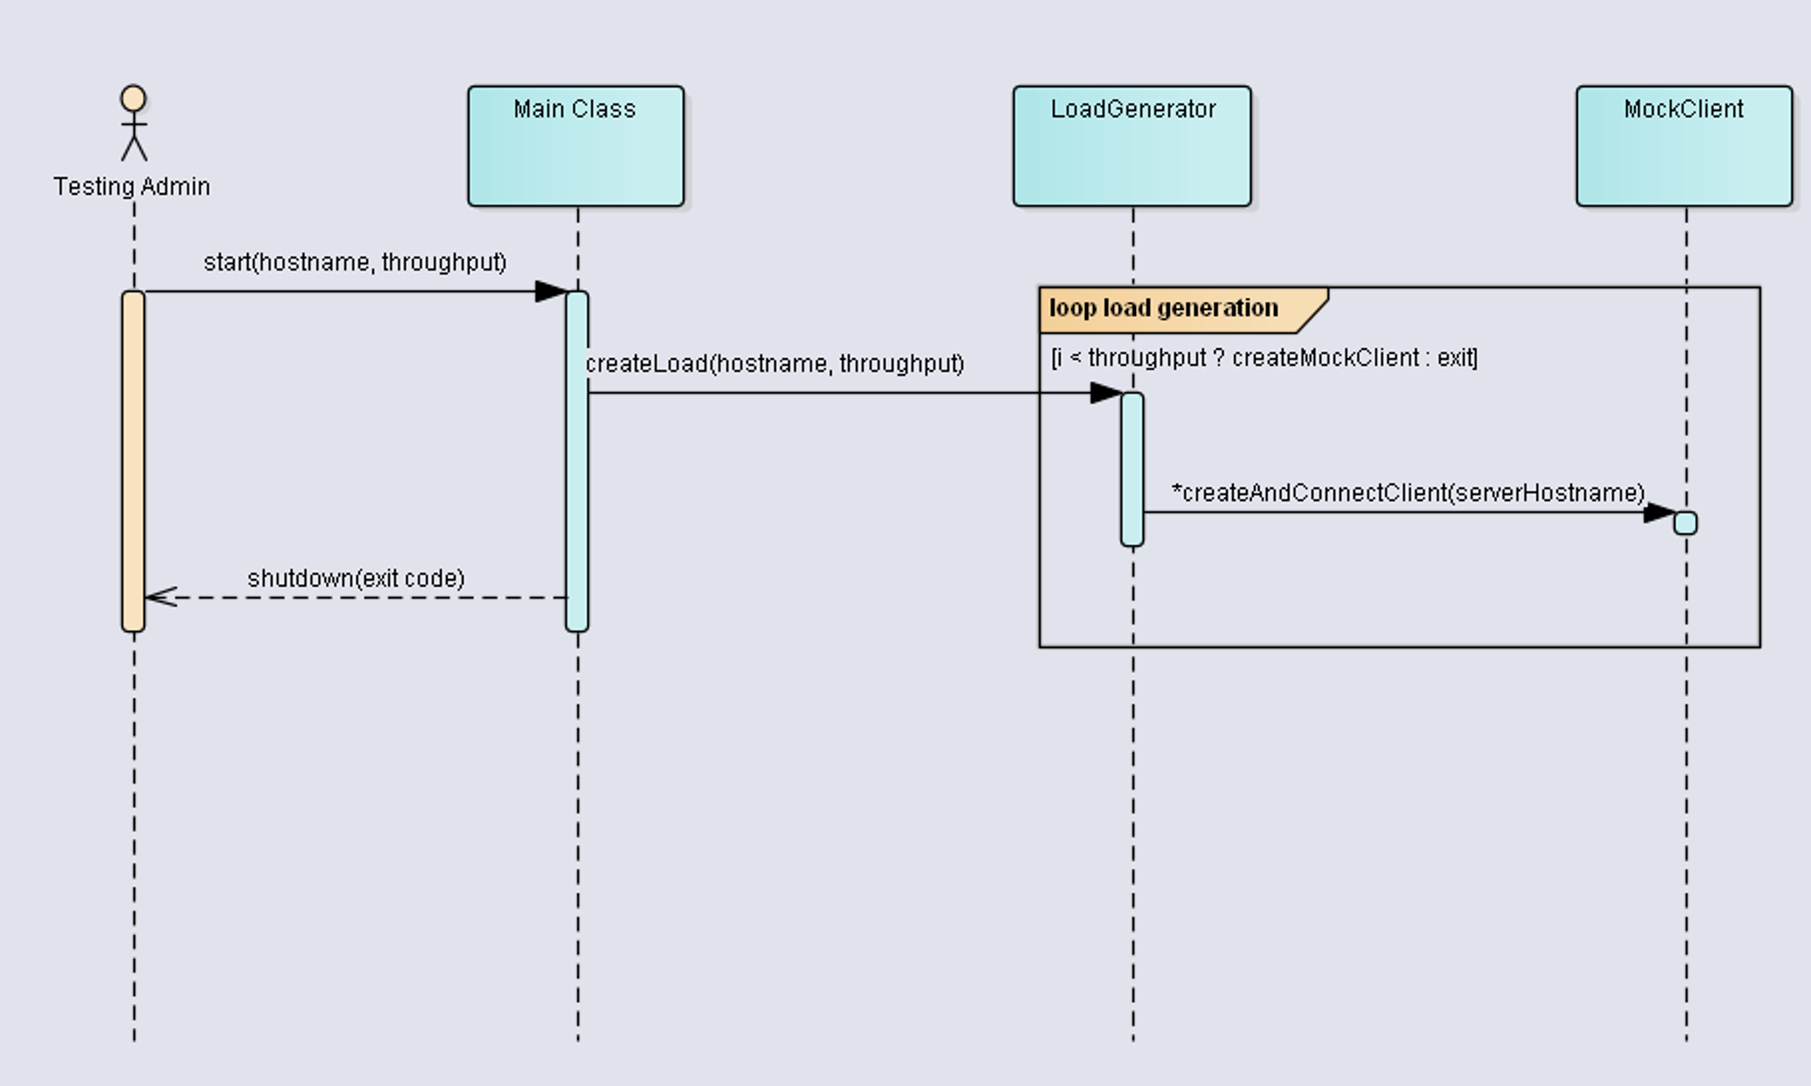
Load generation sequence diagram

Slide 17
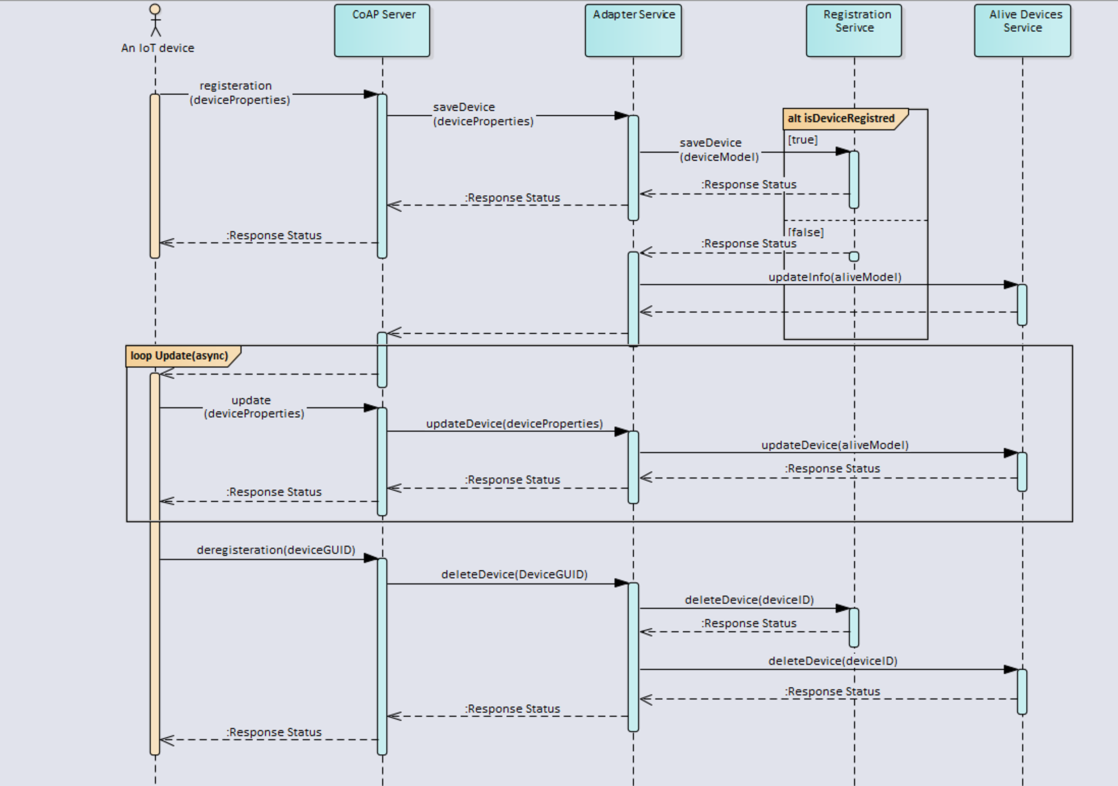
Test scenario sequence diagram

Slide 18
Results
The Results discussion

Slide 19
The measuring system
To measure response we used distributed tracing system.
We stored trace logs in document-oriented DB.
We used search engine to retrieve and analyze logs

Slide 20
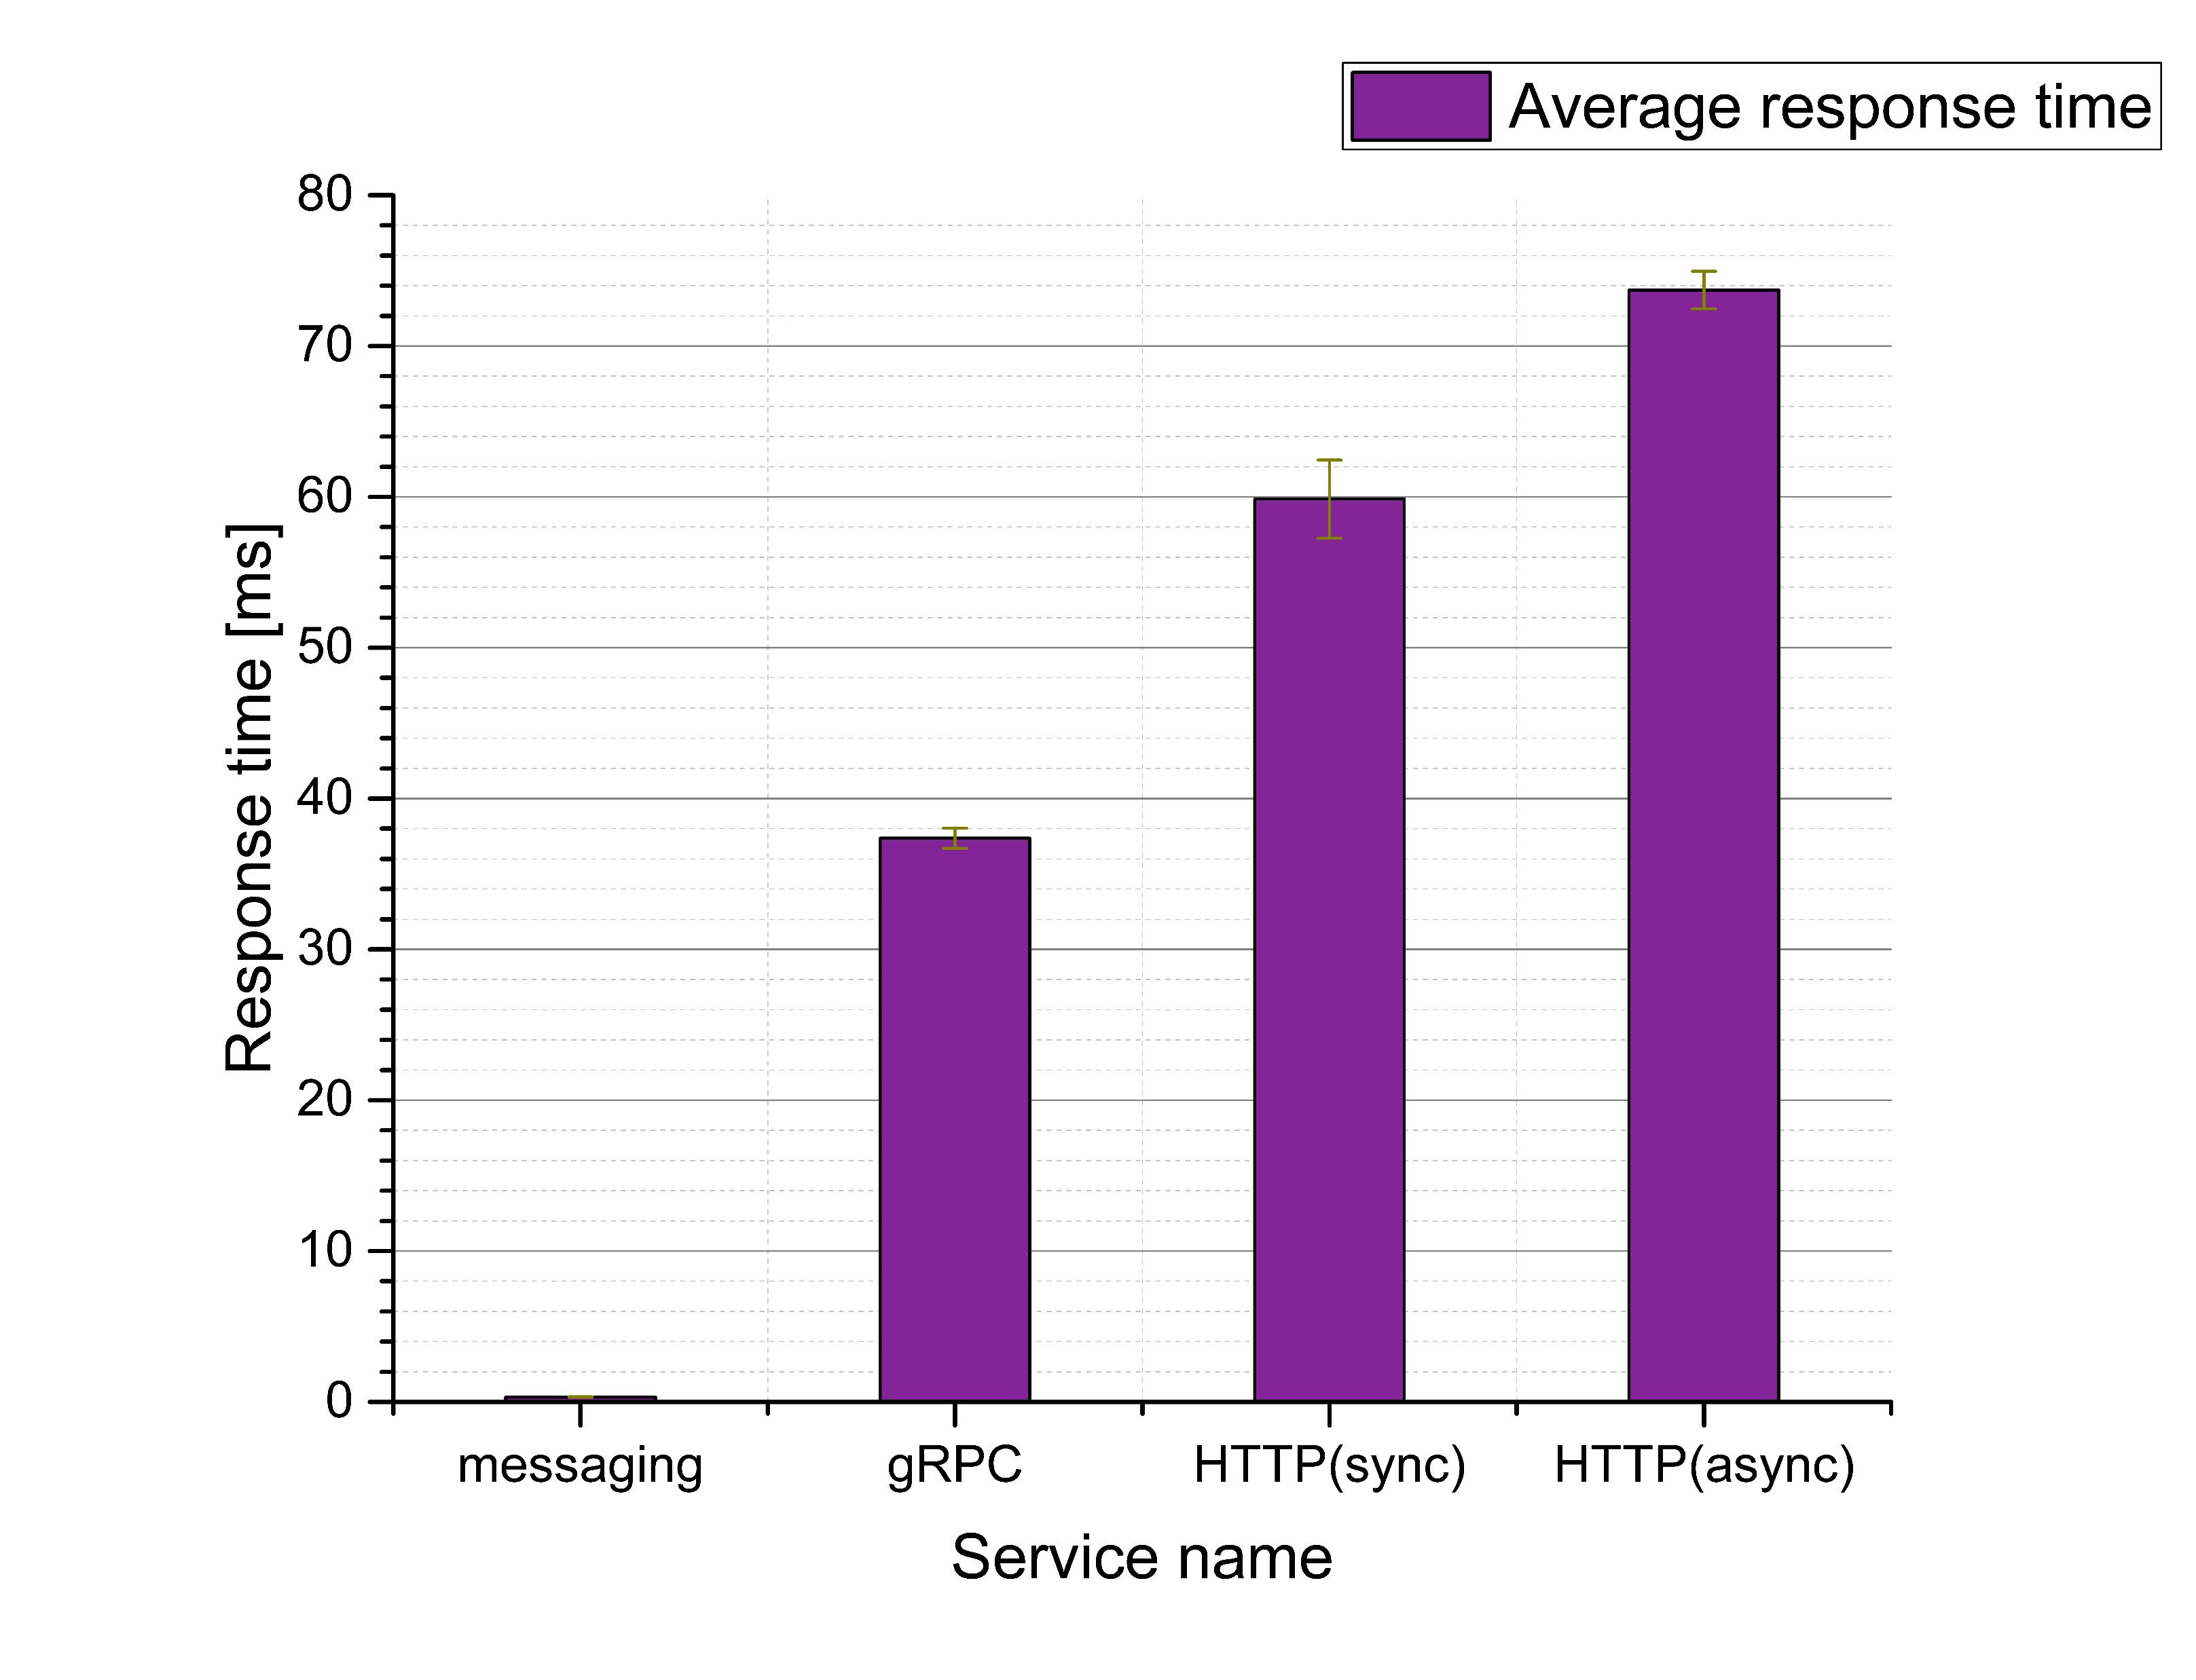
Interconnection comparison
Messaging provides the lowest response time less than 1 millisecond.
Async. HTTP provides the highest response time, a bit higher 70 milliseconds.

Slide 21
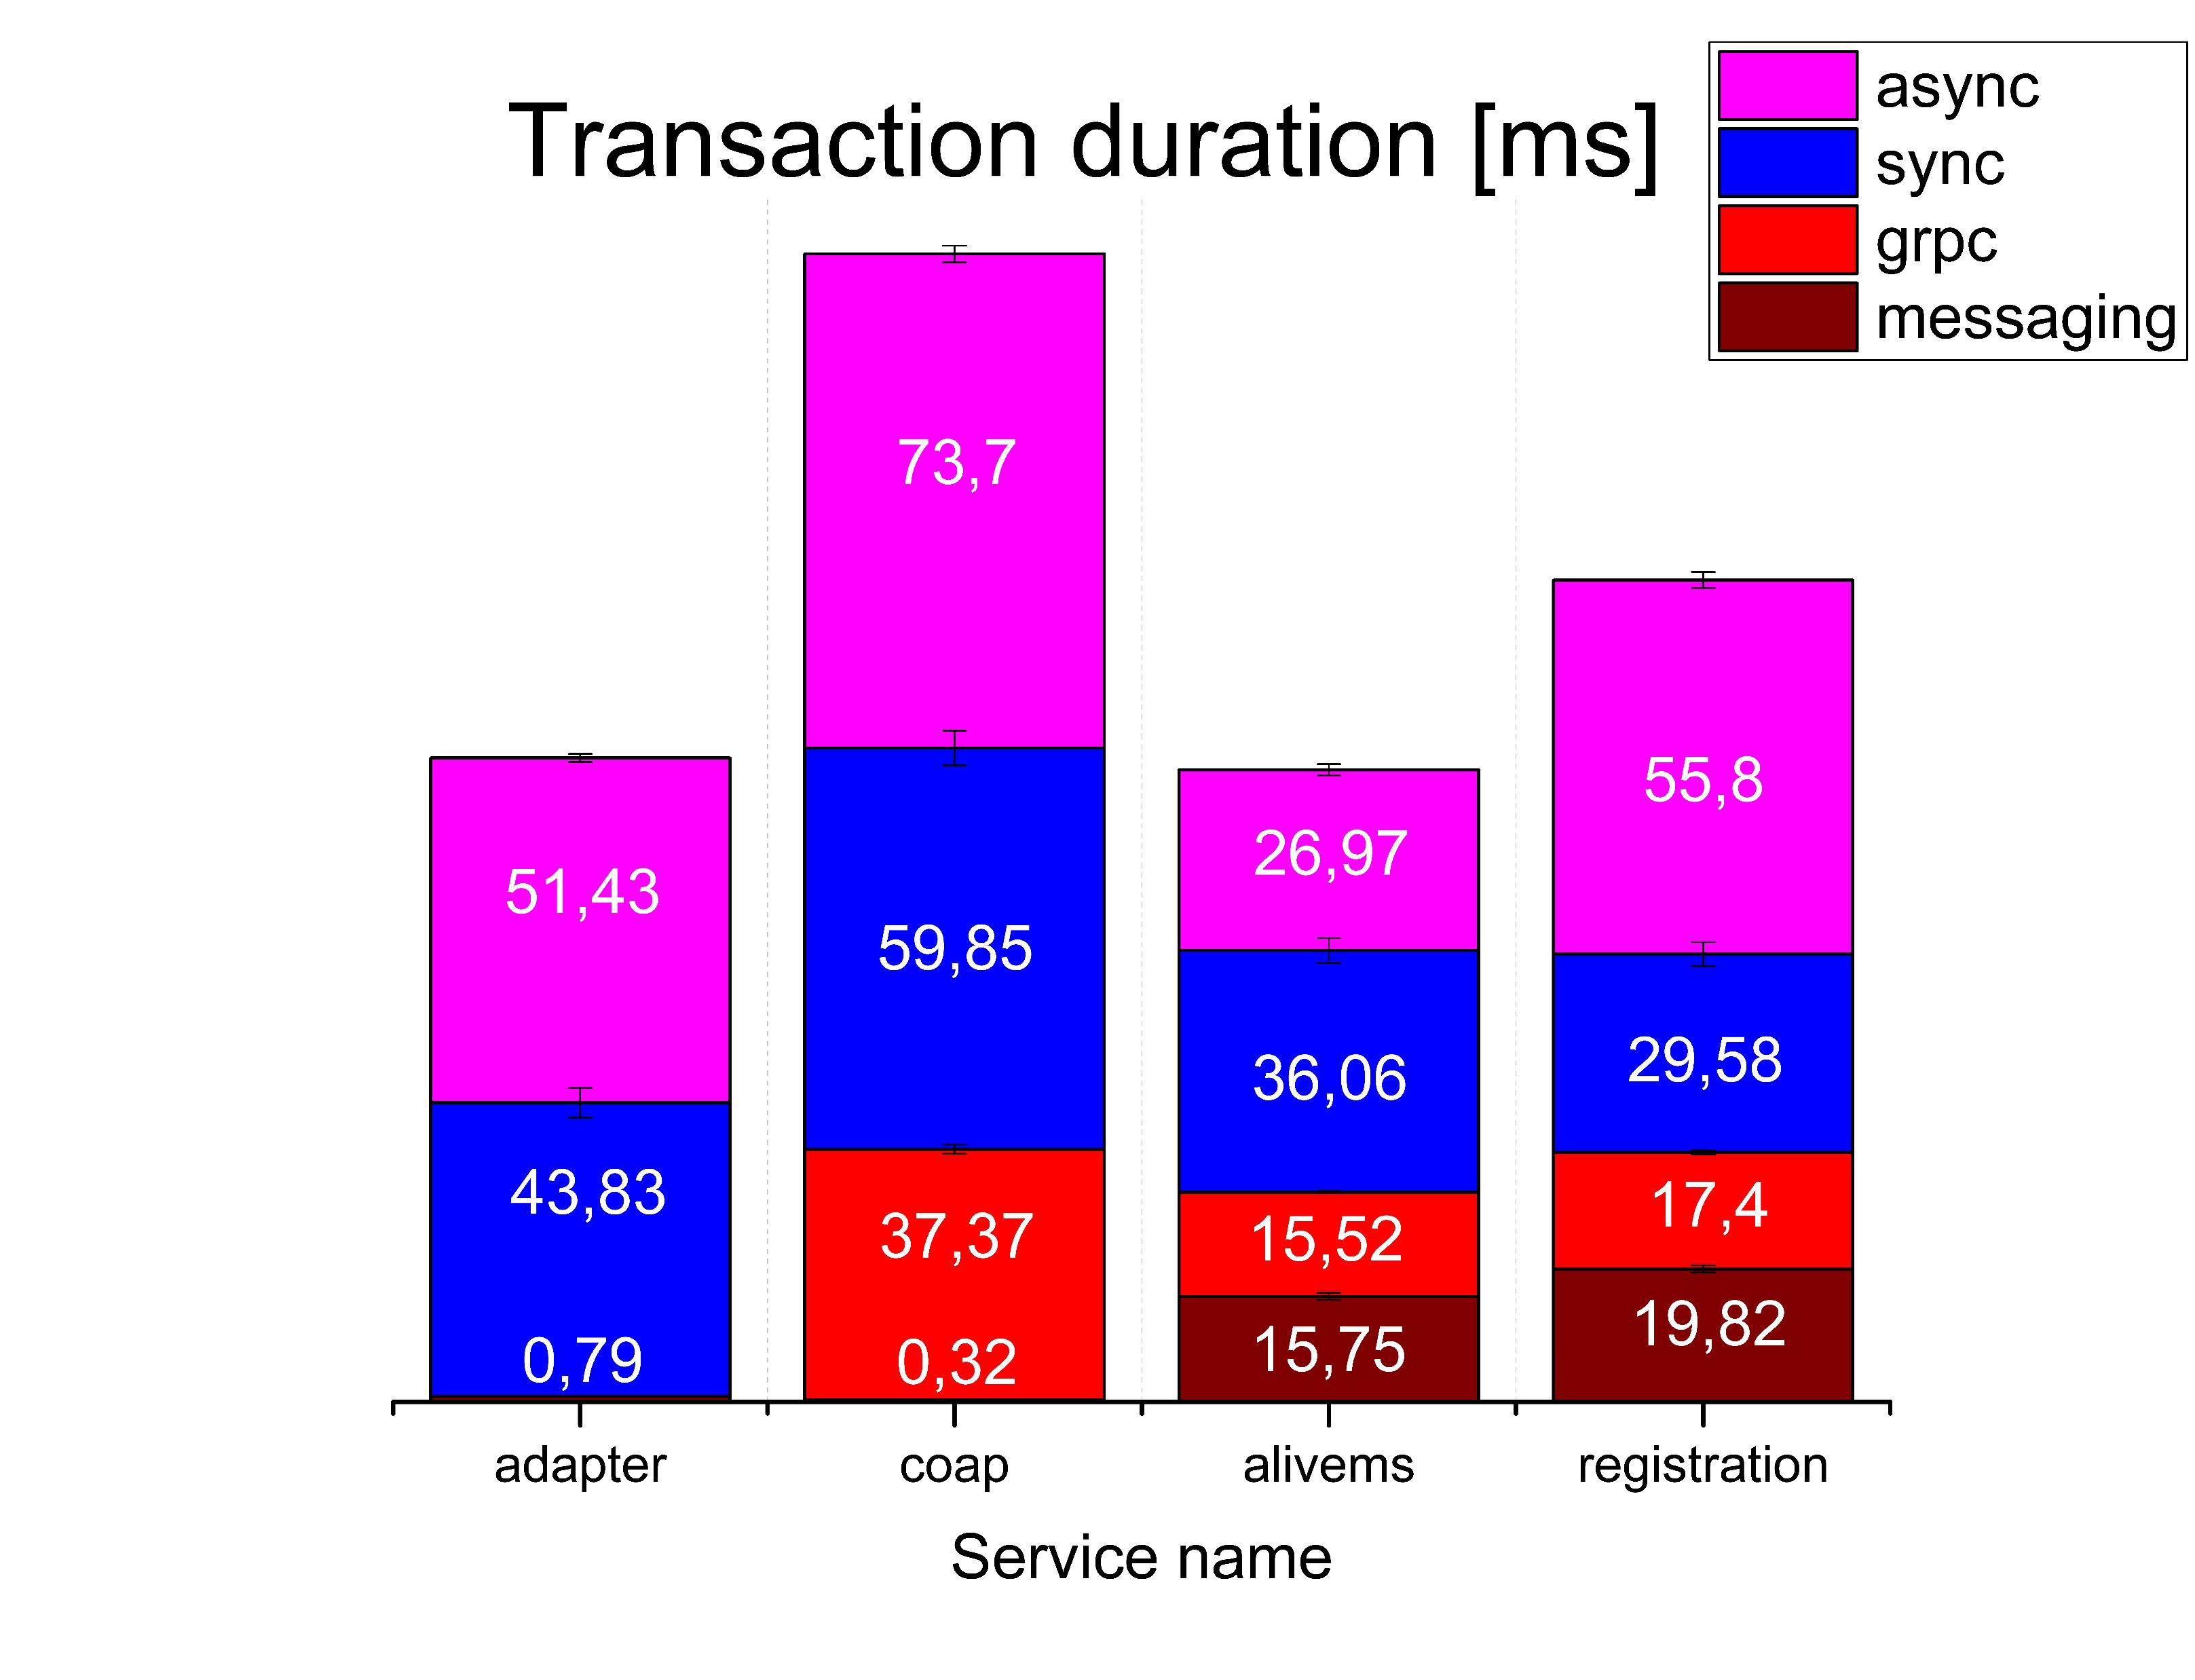
Transaction duration by service
gRPC interconnection provides lowest transaction duration time of persistence services.
The messaging one provides the lowest transaction duration time of non-persistence services.

Slide 22
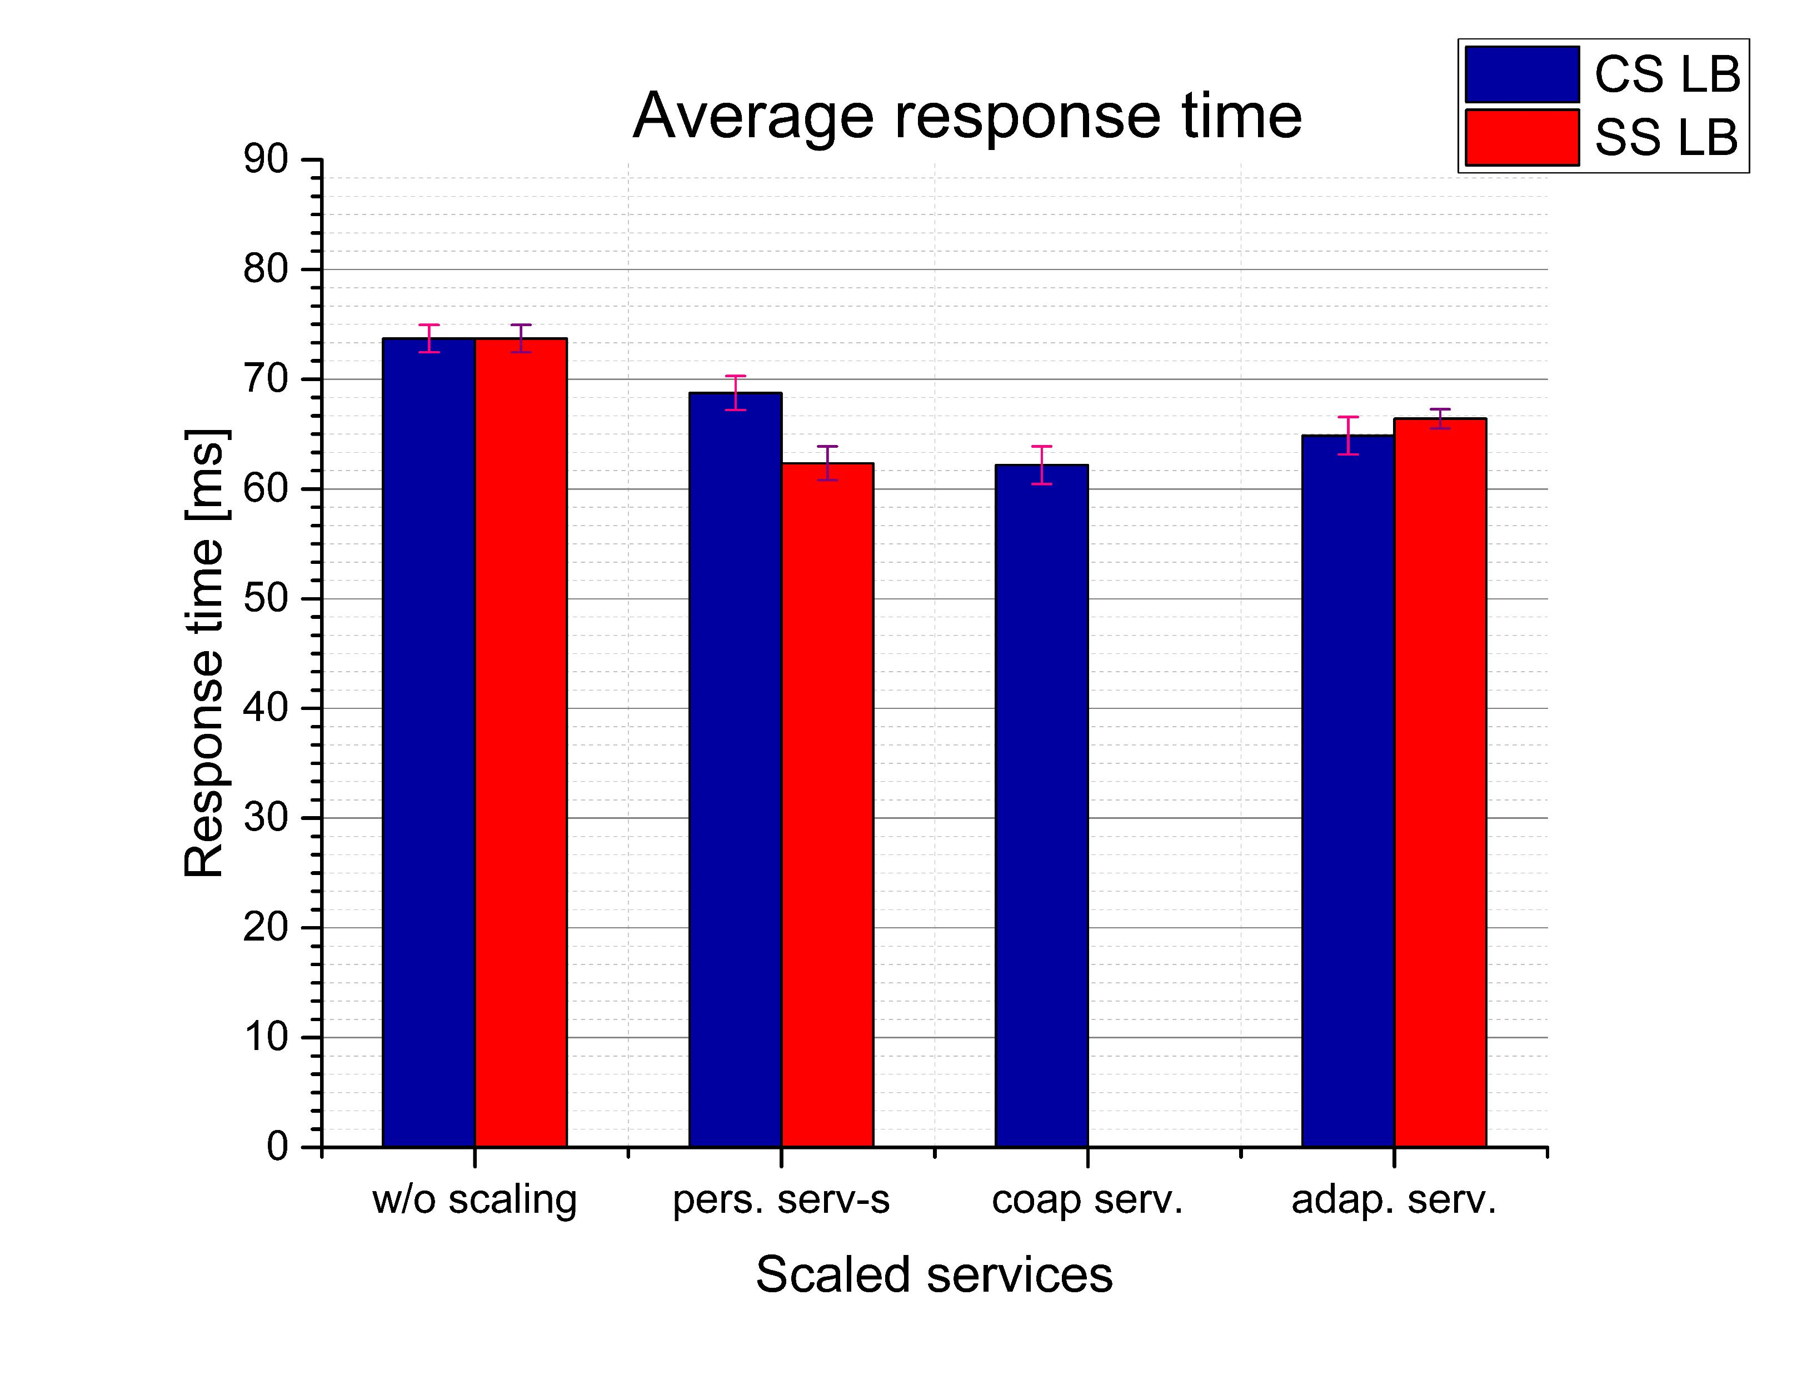
Load balancing strategies comparison
Client-side LB strategy provides about 10% less the system response time, scaling persistency services.
Server-side LB strategy improves the system response by almost the same amount but by scaling edge service.

Slide 23
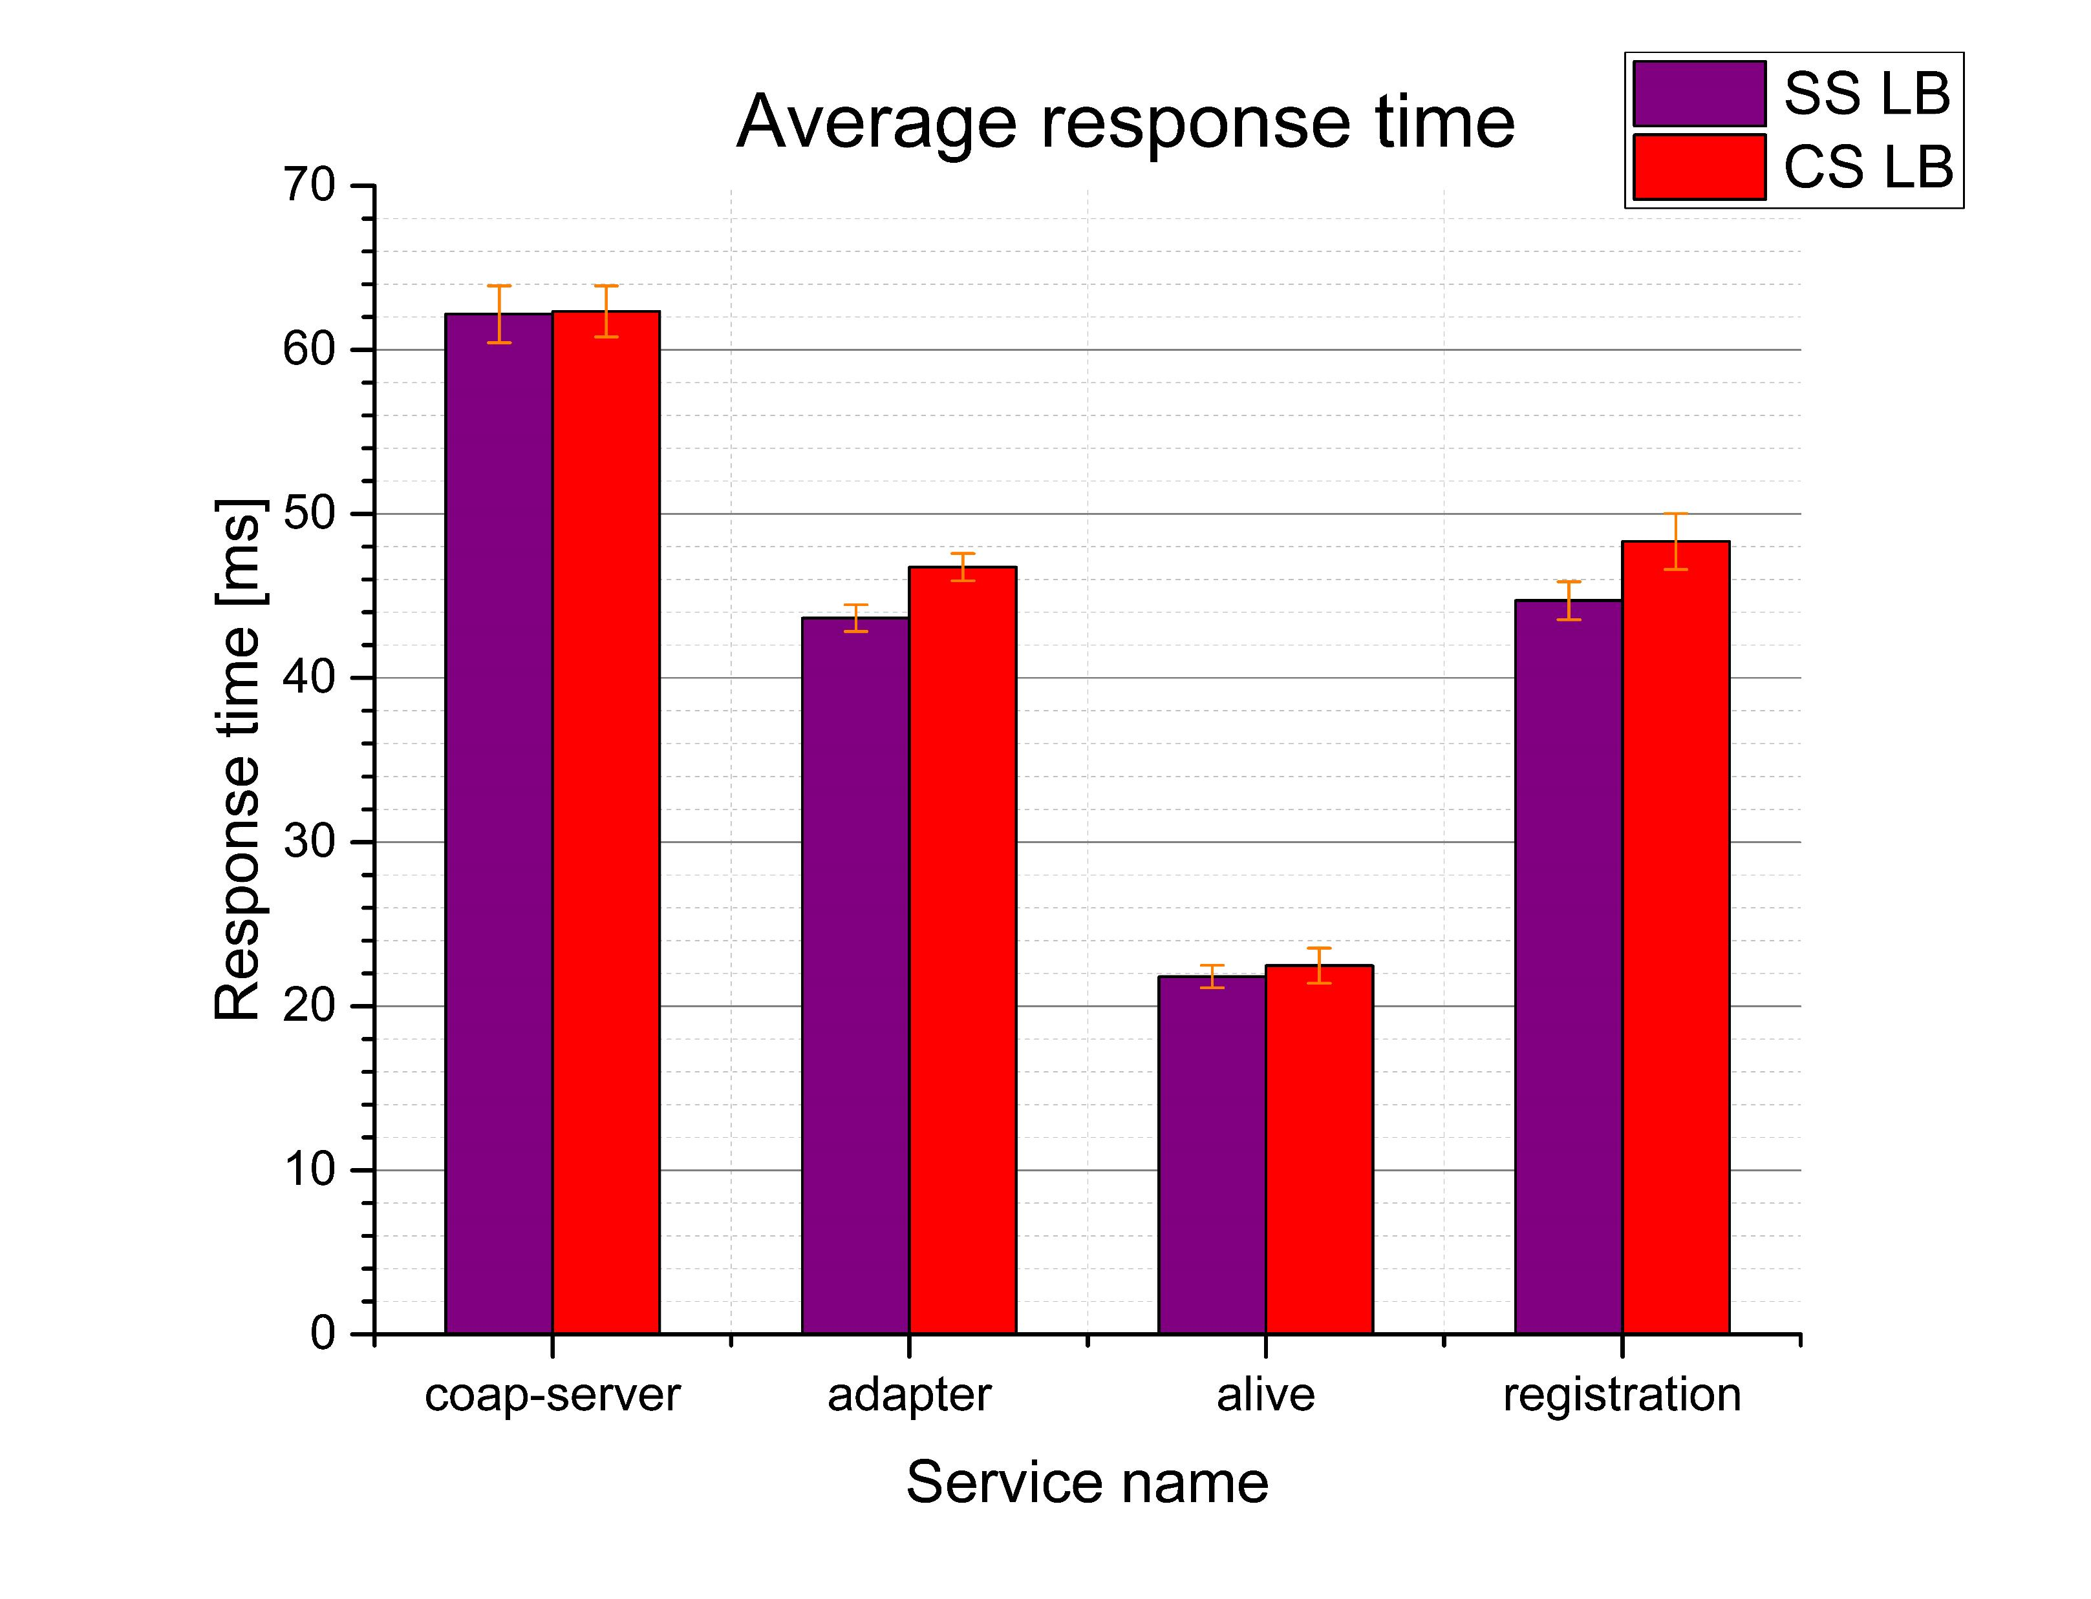
Impact of LB on services
Here need to add additional info on the plot

Slide 24
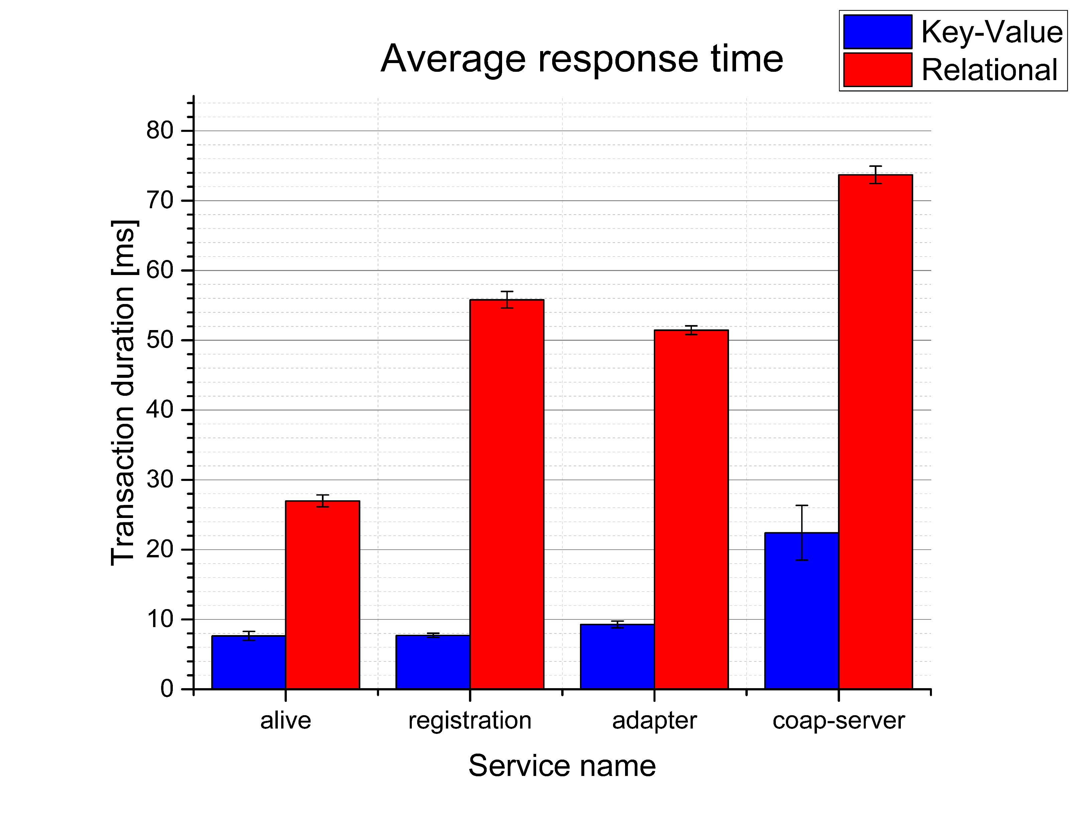
DBMS comparison
Key-Value DBMS requires significantly less time to execute database operations.
Despite a data structure it needs about 8 milliseconds to process an operation.

Slide 25
Conclusion
Summing up the thesis

Slide 26
Conclusion
The fastest an IoT device request handling can provide a microservice system with messaging middleware interconnection to non-persistency services and gRPC interconnection to persistency services.
Document-oriented key-value DBMS can ensure the lowest transaction duration of persistency services.
Load balancing strategy choice depends on where a microservice system has a bottleneck.

Slide 27
Future work
To test the microservice system with some additional services satisfying more realistic requirements.
Improve the load generation.
Survey about how caching might affect the system response time.
Prove our research on a production made application.

Slide 28
Thank you for attention

